Slide 1


Jibrin Abdullahi Dallatu
Wednesday, 04 October 2023

Slide 2

Outline
Executive Summary
Introduction
Methodology
Results
Conclusion
Appendix

Slide 3
Executive Summary
Summary of methodologies
Summary of all results

Slide 4
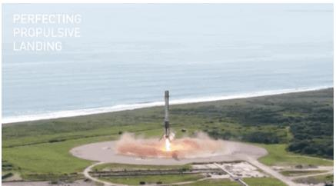
Introduction
• Project background and c ontext
SpaceX advertises Falcon 9 rocket launches on its website with a cost of 62 million dollars; other providers cost upward of 165 million dollars each, much of the savings is because SpaceX can reuse the first stage. Therefore if we can determine if the first stage will land, we can determine the cost of a launch. This information can be used if an alternate company wants to bid against SpaceX for a rocket launch.
• Problems you want to find answers
In this capstone, we will predict if the Falcon 9 first
stage will land successfully u sing d ata from Falcon 9
rocket launches a dvertised on its website.

Slide 5

Section 1

Slide 6
Methodology
Executive Summary
Data collection methodology:
Describe how data was collected
Perform data wrangling
Describe how data was processed
Perform exploratory data analysis (EDA) using visualization and SQL
Perform interactive visual analytics using Folium and Plotly Dash
Perform predictive analysis using classification models
How to build, tune, evaluate classification models

Slide 7
Data Collection
Describe how data sets were collected.
• Data was first collected using SpaceX API (a RESTful API) by making a get request to the SpaceX API. T his was done by first defining a series helper functions that w ould help in the use of the API to extract information using identification numbers in the launch data and then requesting rocket launch data from the SpaceX API u rl.
• Finally to make the requested JSON results more consistent, the SpaceX launch data was
requested and parsed using the GET request and then decoded the response content as a
Json result which was then converted into a Pandas data frame.
• Also performed web scraping to collect Falcon 9 historical launch records from a Wikipedia page titled List of Falcon 9 and Falcon Heavy l aunches of the launch records are stored in a HTML. Using BeautifulSoup and request Libraries, I extract the Falcon 9 launch HTML table records from the Wikipedia page, Parsed the table and converted it into a Pandas data frame

Slide 8
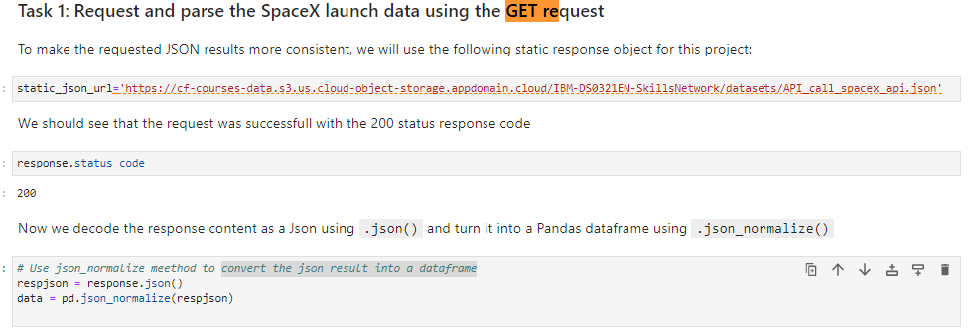
Data Collection – SpaceX API
Present your data collection with SpaceX REST calls using key phrases and flowcharts
Add the GitHub URL of the completed SpaceX API calls notebook (must include completed code cell and outcome cell), as an external reference and peer-review purpose
Place your flowchart of SpaceX API calls here

Slide 9
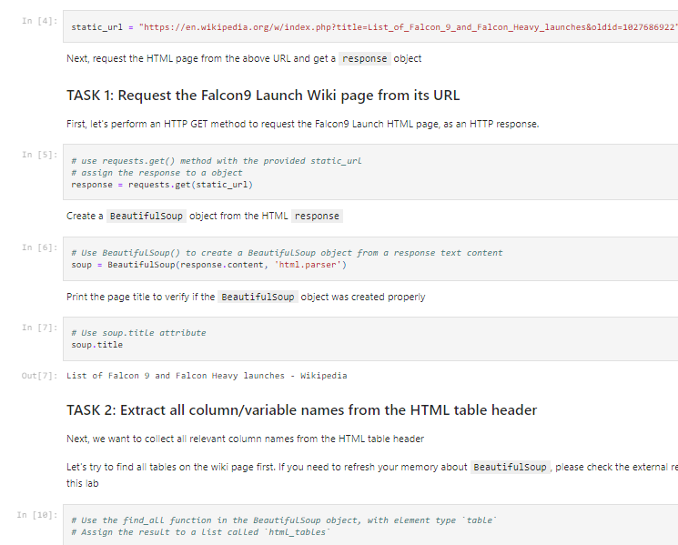
Data Collection - Scraping
Performed web scraping to collect Falcon 9 historical launch records from a Wikipedia using BeautifulSoup and request, to extract the Falcon 9 launch records from HTML table of the Wikipedia page, then created a data frame by parsing the launch HTML. Add the GitHub URL of the completed web scraping notebook, as an external reference and peer-review purpose
• Here is the GitHub URL of the completed web scraping notebook.
Place your flowchart of web scraping here

Slide 10
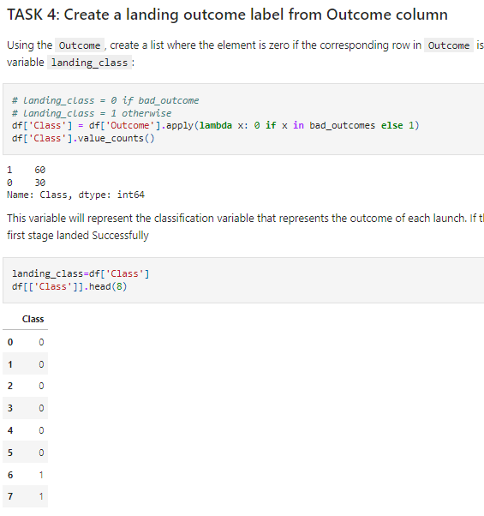
Data Wrangling
• After obtaining and creating a Pandas DF from the collected data, data was filtered using the BoosterVersioncolumn to only keep the Falcon 9 launches, then dealt with the missing data values in the LandingPad and PayloadMasscolumns. For the PayloadMass, missing data values were replaced using mean value of column.
Also performed s ome Exploratory Data Analysis (EDA) to find some patterns in the data and determine what would be the label for training supervised models
Here i s the GitHub U RL of t he completed d ata wrangling related n otebooks.

Slide 11
EDA with Data Visualization
Performed d ata A nalysis and Feature Engineering using Pandas and Matplotlib.i.e.
• Exploratory Data Analysis
• Preparing Data Feature Engineering
• Used scatter plots to Visualize therelationship between Flight Number and Launch Site, Payload and Launch Site, F lightNumber and Orbit type, Payload and Orbit type.
• Used Bar chart t o Visualize the relationship between success rate of each orbit type
• Line plot to Visualize the launch success yearly t rend.
• Here i s t he GitHub URL of your completed EDA with data visualization notebook, (https://github.com/cgatama/SpaceX-Falcon-9-1st-stage-Success-Landing-Prediction/blob/main/5.%20SpaceX%20EDA%20DataViz%20Using%20Pandas%20and%20Matplotlib%20-%20SpaceX.ipynb)

Slide 12
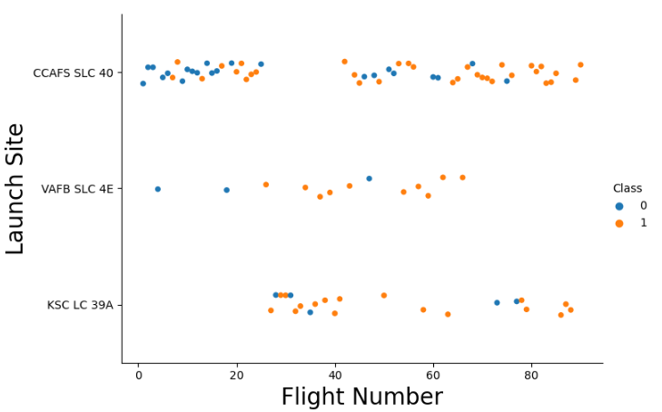
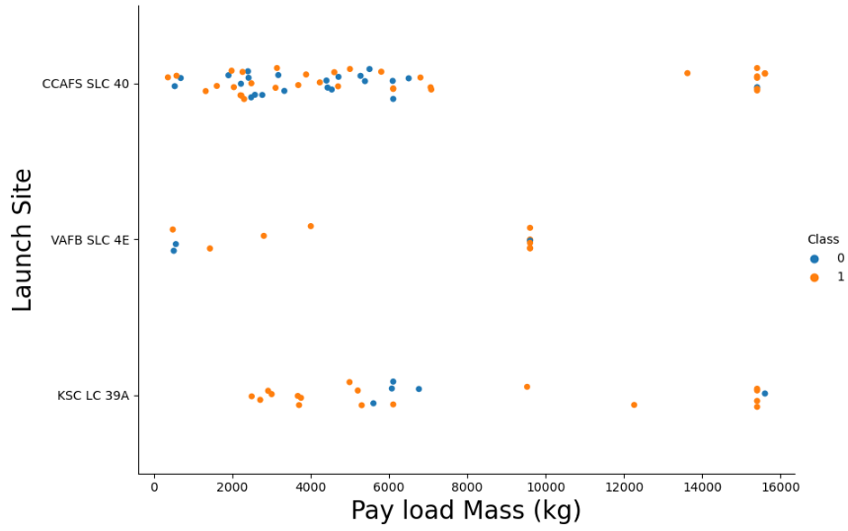
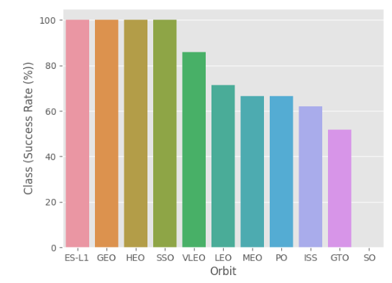
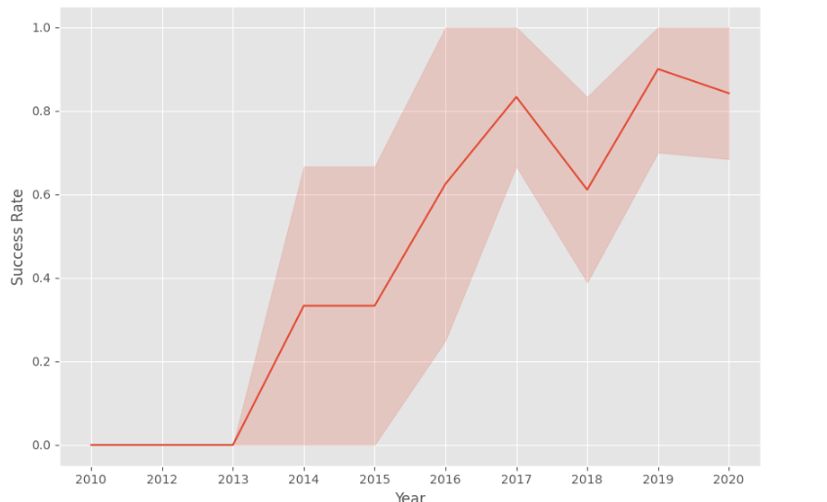
EDA with Data Visualization (Plots Cont….)

Slide 13
EDA with SQL
• The following SQL queries were performed for EDA
• The following SQL queries were performed for EDA
• Display 5 records where launch sites begin with the string 'CCA‘
• Display the total payload mass carried by boosters launched by NASA (CRS)
• Display average payload mass carried by booster version F9 v1.1

Slide 14
EDA with SQL (Cont.…)
• List the date when the first successful landing outcome in ground pad was achieved
• List the names of the boosters which have success in drone ship and have payload
mass greater than 4000 but less than 6000 (%sqlSELECT DISTINCT Booster_Version, Payload
FROM SPACEXTBL WHERE "Landing _Outcome" = "Success (drone ship)" AND PAYLOAD_MASS__KG_ > \4000 AND PAYLOAD_MASS__KG_ < 6000;)
• List the total number of successful and failure mission outcomes
• Here is the GitHub URL of your completed EDA with SQL notebook.
(https://github.com/cgatama/SpaceX-Falcon-9-1st-stage-Success-Landing-Prediction/blob/main/4.%20Space-
X%20EDA%20Using%20SQL.ipynb)

Slide 15
Build an Interactive Map with Folium
• Created folium map to marked all the launch sites, and created map objects such as markers, circles, lines to mark the success or failure of launches for each launch site.
• Created a launch set outcomes (failure=0 or success=1).
• Here is the GitHub URL of the completed interactive map with Folium map, as an external reference and peer-review purpose (https://github.com/cgatama/SpaceX-Falcon-9-1st-stage-Success-Landing-Prediction/blob/main/6.Space-X%20Launch%20Sites%20Locations%20Analysis%20with%20Folium-Interactive%20Visual%20Analytics.ipynb)

Slide 16
Build a Dashboard with Plotly Dash
Built a n interactive dashboard application with Plotly dash by:
• Adding a Launch Site Drop-down Input Component
• Adding a callback function to render success-pie-chart based on selected site dropdown
• Adding a Range Slider to Select Payload
• Addeng a callback function to render the success-payload-scatter- chart scatter plot
Explain why you added those plots and interactions
• Here is the GitHub URL of your completed Plotly Dash lab (https://github.com/cgatama/SpaceX-Falcon-9-1st-stage-Success-Landing-Prediction/blob/main/7.%20Build%20an%20Interactive%20Dashboard%20with%20Ploty%20Dash%20-%20spacex_dash_app.py)

Slide 17
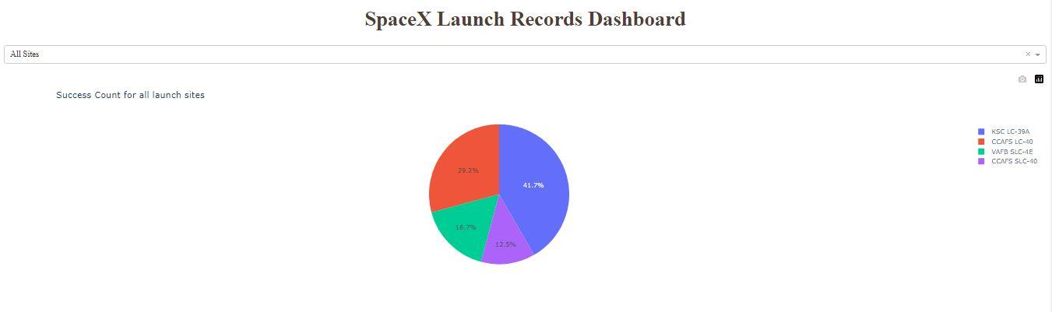
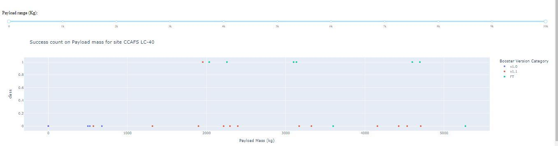
SpaceX Dash App

Slide 18
Predictive Analysis (Classification)
• Summary of how I built, evaluated, improved, and found the best performing classification m odel
After loading the data as a Pandas Dataframe, I set out to perform exploratory Data Analysis and determine Training Labels by;
• creating a NumPy array from the column Class in data, by applying the method
to_numpy() then assigned it to the variable Y as the outcome variable.
• Then standardized the feature dataset (x) by transforming it using preprocessing.StandardScaler() function from Sklearn.
• After w hich the data was split into training and testing s ets using the function
train_test_split from sklearn.model_selection with the test_size parameter set to 0 .2
and random_state to 2 .

Slide 19
Predictive Analysis (Classification)
• In order to find the best ML model/ method that would performs best using the test data between SVM, Classification Trees, k nearest neighbors and Logistic Regression;
• First created an object for each of the algorithms then created a GridSearchCV object and assigned them a set of parameters for each model.
• For each of the models under evaluation, the GridsearchCV object was created with cv=10, then fit the training data into the GridSearch object for each to Find best Hyperparameter.
• After fitting the training set, we output GridSearchCV object for each of the models, then displayed the best parameters using the data attribute best_params_ and the accuracy on the validation data using the data attribute best_score_.
• Finally using the method score to calculate the accuracy on the test data for each model and plotted a confussion matrix for each using the test and predicted outcomes.

Slide 20
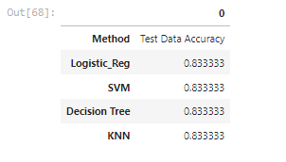
Predictive Analysis (Classification)
• The table below shows the test data accuracy score for each of the methods comparing them to show which performed best using the test data between SVM, Classification Trees, k nearest neighbors and Logistic Regression;
• GitHub URL of the completed predictive analysis lab
(https://github.com/cgatama/SpaceX-Falcon-9-1st-stage-Success-Landing_x0002_Prediction/blob/main/8.%20SpaceX%20Machine%20Learning%20Prediction.ipynb)

Slide 21
Results
Exploratory data analysis results
Interactive analytics demo in screenshots
Predictive analysis results

Slide 22

Section 2

Slide 23
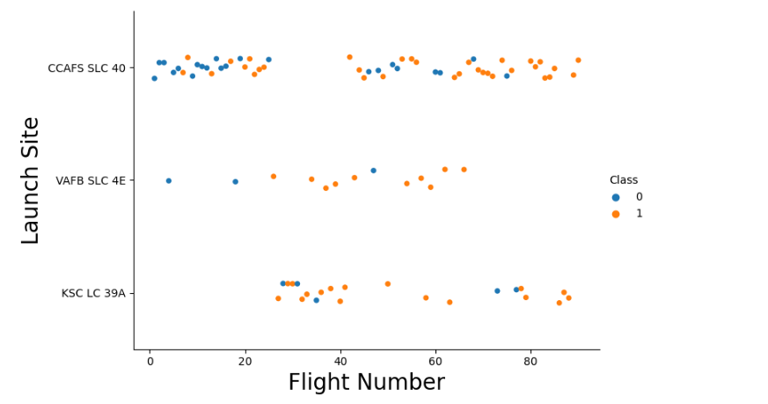
Flight Number vs. Launch Site
A scatter plot of Flight Number vs. Launch Site

Slide 24
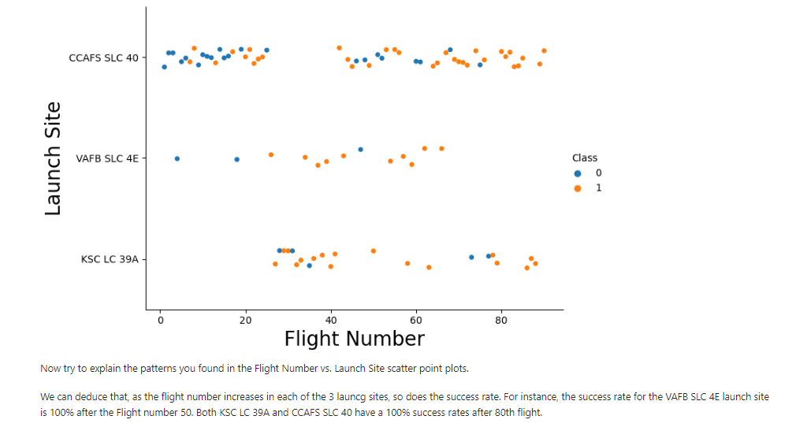
Flight Number vs. Launch Site with explanations
A scatter plot with explanations Flight Number vs. Launch Site

Slide 25
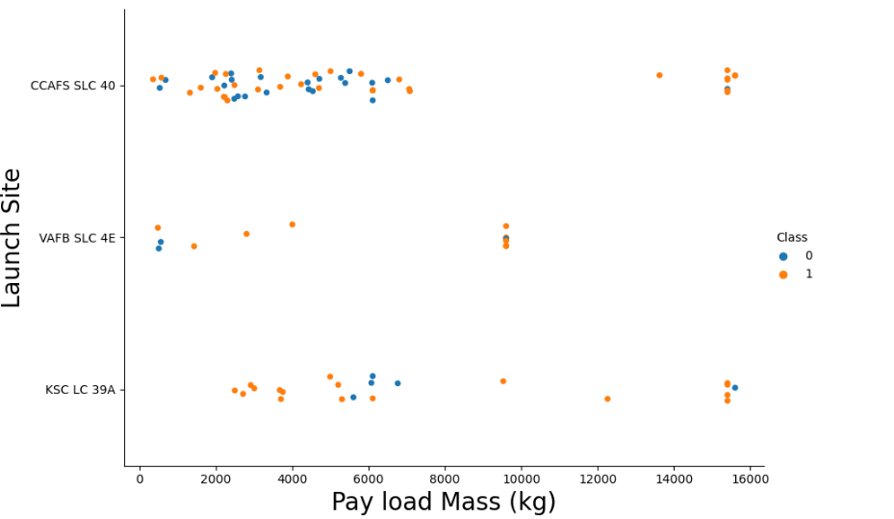
Payload vs. Launch Site
A scatter plot of Payload vs. Launch Site

Slide 26
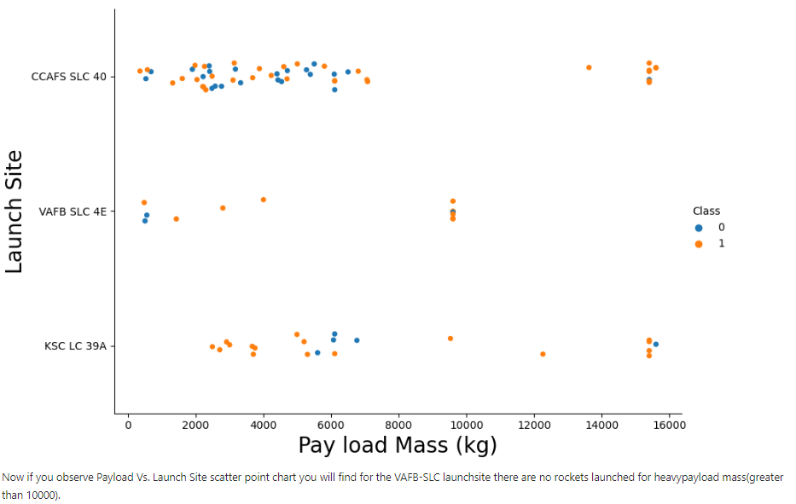
Payload vs. Launch Site with explanations
A scatter plot of Payload vs. Launch Site

Slide 27
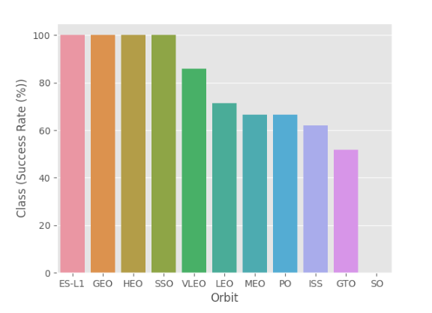
Success Rate vs. Orbit Type
• Show a bar chart for the success rate of each orbit type

Slide 28
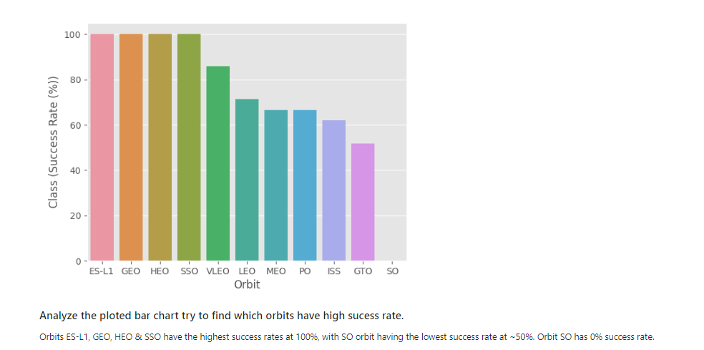
Success Rate vs. Orbit Type with explanations
• Show the screenshot of the bar chart with explanations

Slide 29
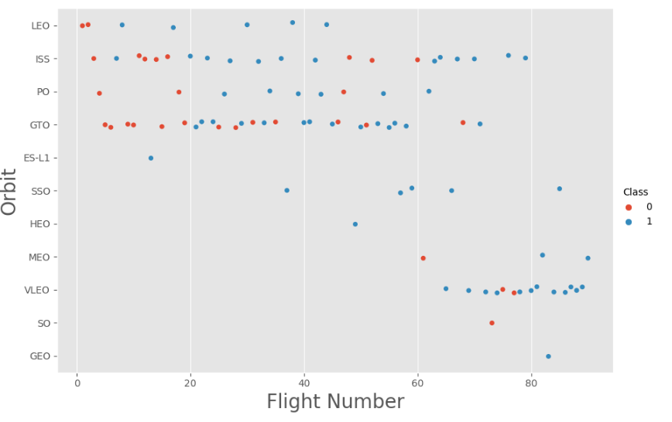
Flight Number vs. Orbit Type
• A scatter point of Flight number vs. Orbit type

Slide 30
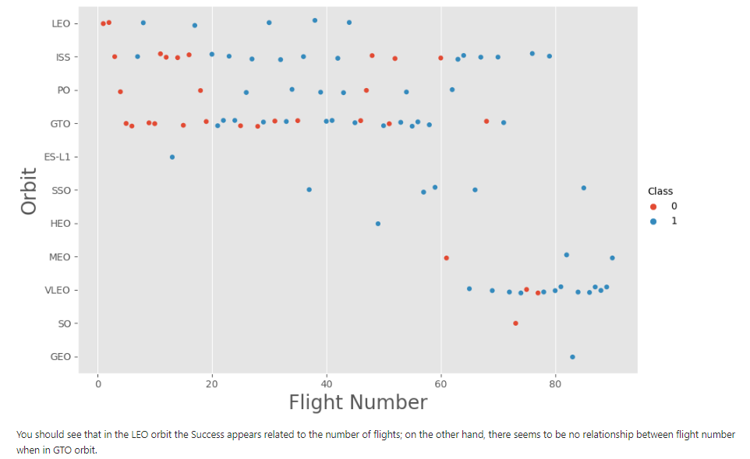
Flight Number vs. Orbit Typewith explanations

Slide 31
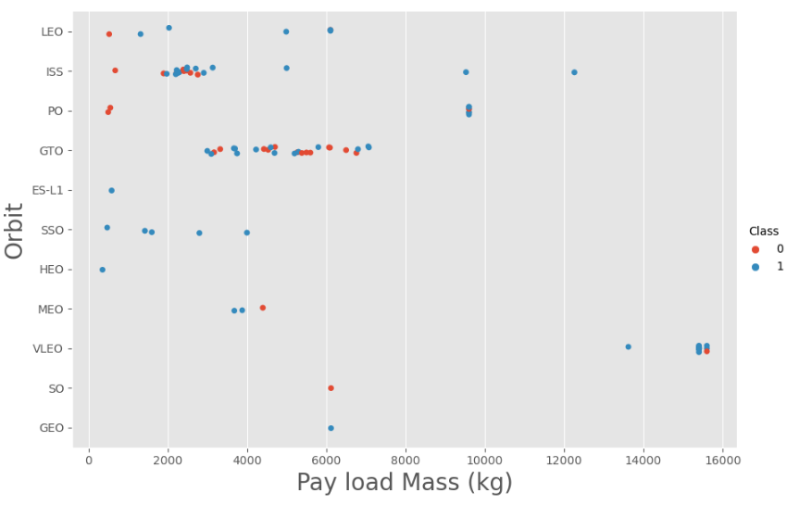
Payload vs. Orbit Type
• With heavy payloads the successful landing or positive landing rate are more for Polar,LEO and ISS.
• However for GTO we cannot distinguish this well as both positive landing rate and negative landing(unsuccessful mission) both have near equal chances.

Slide 32
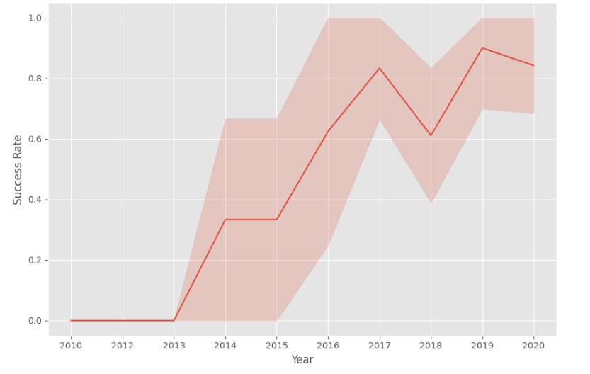
Launch Success Yearly Trend
A line chart of yearly average success rate
• Since 2013, the success rate kept going up till 2020

Slide 33
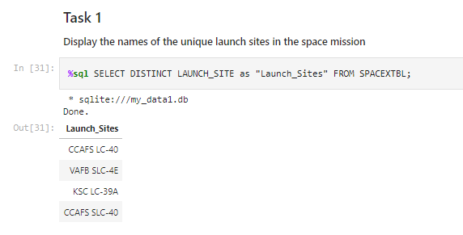
All Launch Site Names
Find the names of the unique launch sites
• Used ‘SELECT DISTINCT’ statement to return only the unique launch sites from the ‘LAUNCH_SITE’ column of the SPACEXTBL table

Slide 34
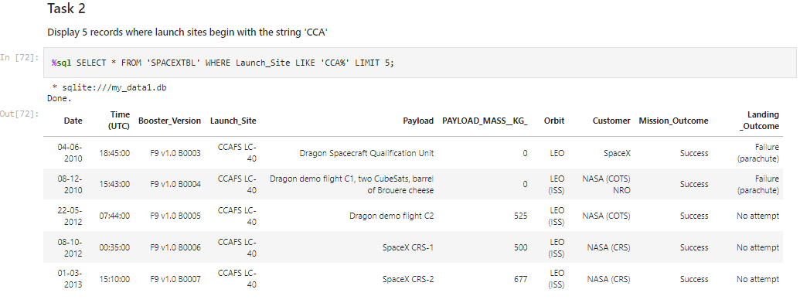
Launch Site Names Begin with 'CCA'
• Find 5 records where launch sites begin with `CCA`
• Used ‘LIKE’ command with ‘%’ wildcard in ‘WHERE’ clause to select and dispay a table of all records where launch sites begin with the string 'CCA'

Slide 35
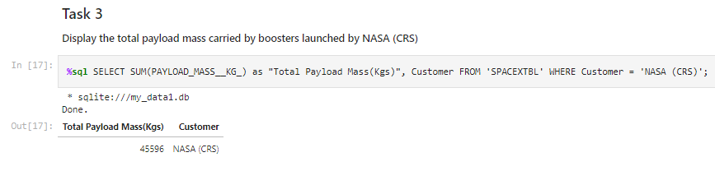
Total Payload Mass
• Calculate and Display the total payload carried by boosters from NASA
• Used the ‘SUM()’ function to return and dispaly the total sum of
‘PAYLOAD_MASS_KG’ column for Customer ‘NASA(CRS’

Slide 36
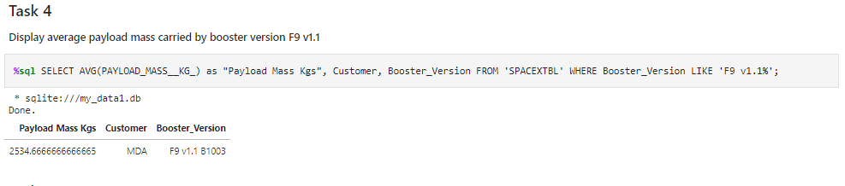
Average Payload Mass by F9 v1.1
• Calculate the average payload mass carried by booster version F9 v1.1
• Used the ‘AVG()’ function to return and dispaly the average payload mass
carried by booster version F9 v1.136

Slide 37
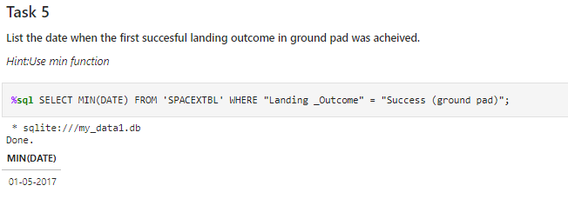
First Successful Ground Landing Date
• Find the dates of the first successful landing outcome on ground pad
• Used the ‘MIN()’ function to return and dispaly the first (oldest) date when first
successful landing outcome on ground pad ‘Success (ground pad)’happened.

Slide 38
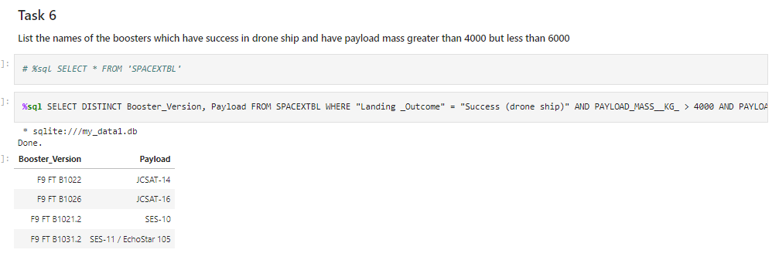
Successful Drone Ship Landing with Payload between 4000 and 6000
• List of Boosters which have successfully landed on drone ship and had payload
mass greater than 4000 but less than 6000
• Used ‘Select Distinct’ statement to return and list the ‘unique’ names of boosters with
operators >4000 and <6000 to only list booster with payloads btween 4000-6000 with
landing outcome of ‘Success (drone ship)’.

Slide 39
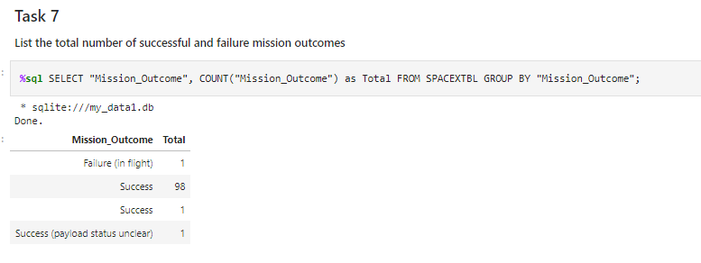
Total Number of Successful and Failure Mission Outcomes
Calculate the total number of successful and failure mission outcomes
• Used the ‘COUNT()’ together with the ‘GROUP BY’ statement to return total number of missions outcomes

Slide 40
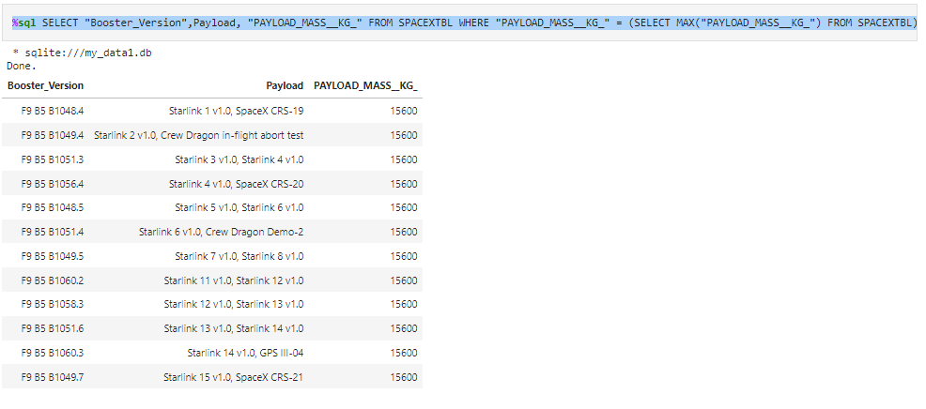
Boosters Carried Maximum Payload
List the names of the booster which have carried the maximum payload mass
• Using a Subquerry to return and pass the Max payload and used it list all the boosters that have carried the Max payload of 15600kgs

Slide 41
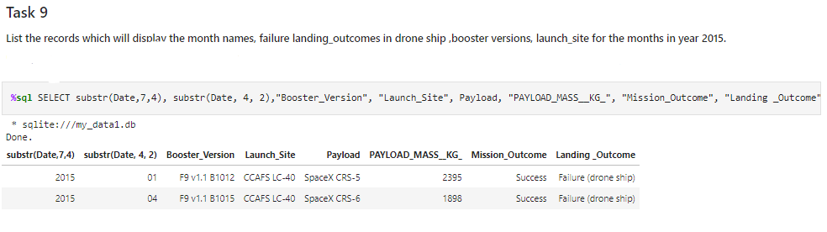
2015 Launch Records
List the failed landing_outcomes in drone ship, their booster versions, and launch site names for in year 2015
• Used the ‘subsrt()’ in the select statement to get the month and year from the date column where substr(Date,7,4)='2015' for year and Landing_outcome was ‘Failure (drone ship’) and return the records nmatching the filter.

Slide 42
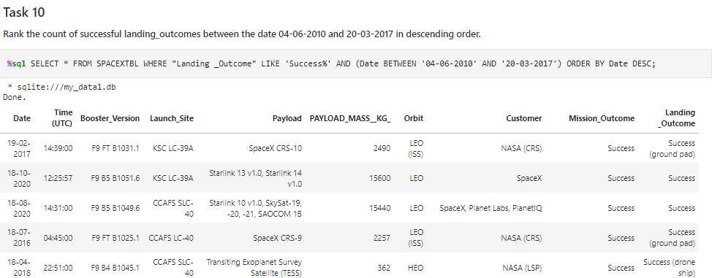
Rank Landing Outcomes Between 2010-06-04 and 2017-03-20
Rank the count of landing outcomes (such as Failure (drone ship) or Success (ground pad)) between the date 2010-06-04 and 2017-03-20, in descending order

Slide 43

Section 3

Slide 44
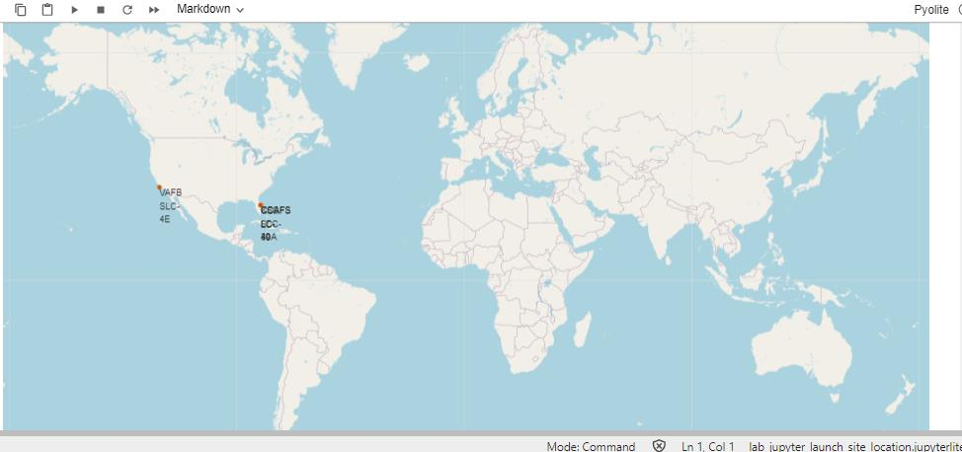
Markers of all launch sites on global map
• All launch sites are in proximity to the Equator, (located southwards of the US
map). Also all the laumch sites are in very close proximity to the coast.

Slide 45
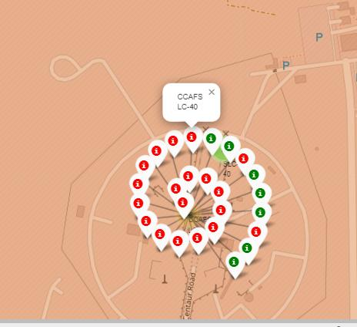
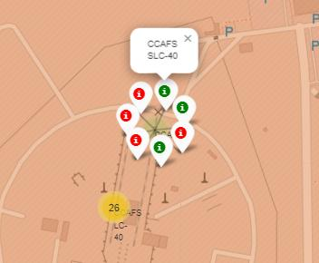
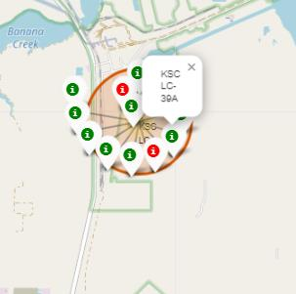
Launch outcomes for each site on the map With Color Markers
Florida Sites
• In the Eastern coast (Florida) Launch site KSC LC-39A has relatively high success rates
compared to CCAFS SLC-40 & CCAFS LC-40.

Slide 46
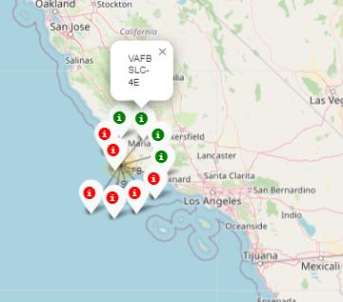
Launch outcomes for each site on the map With Color
Markers
West Coast/ Carlifonia
• In the West Coast
(Californai) Launch
site VAFB SLC-4E has
relatively lower
success rates 4/10
compared to KSC LC-
39A launch site in the
Eastern Coast of
Florida.

Slide 47
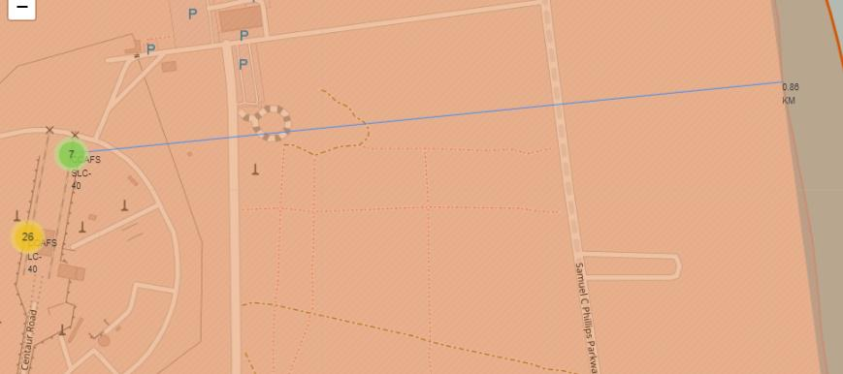
Distances between a launch site to its proximities
• Launch site CCAFS SLC-40 proximity to coastline is 0.86km

Slide 48
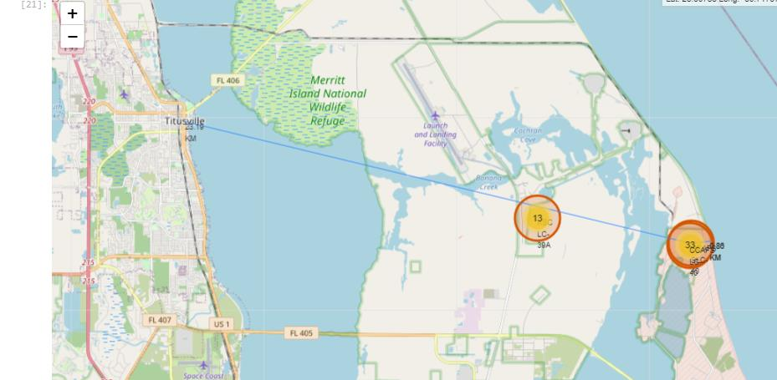
Distances between a launch site to its proximities
• Launch site CCAFS SLC-40 closest to highway (Washington
Avenue) is 23.19km

Slide 49

Section 4

Slide 50
Pie-Chart for launch success count for all sites
• Launch site KSC LC-39A has the highest launch success rate at 42% followed by CCAFS LC-40 at 29%, VAFB SLC-4E at 17% and lastly launch site CCAFS SLC-40 with a success rate of 13%

Slide 51
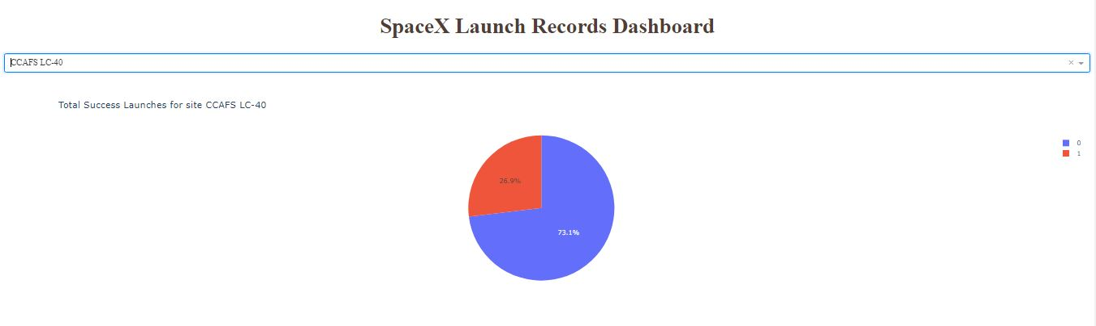
Pie chart for the launch site with 2nd highest launch success ratio
• Launch site CCAFS LC-40 had the 2nd highest success ratio of 73% success against 27% failed launches

Slide 52
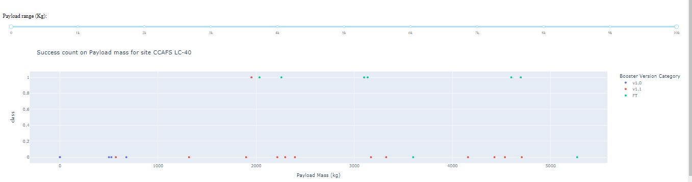
Payload vs. Launch Outcome scatter plot for all sites
• For Launch site CCAFS LC-40 the booster version FT has the largest success rate from a payload mass of >2000kg

Slide 53

Section 5

Slide 54
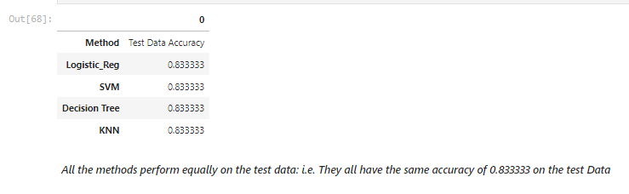
Classification Accuracy

Slide 55
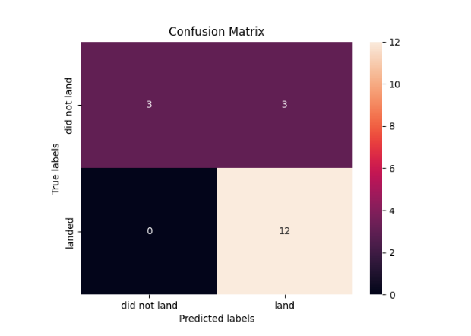
Confusion Matrix
• All the 4
classification
model had the
same confusion
matrixes and were able equally
distinguish
between the
different classes.
The major
problem is false
positives for all
the models

Slide 56
Conclusions
• Different launch sites have different success rates. CCAFS LC-40, has a success rate of 60 %, while KSC LC-39A and VAFB SLC 4E has a success rate of 77%.
• We can deduce that, as the flight number increases in each of the 3 launcg sites, so does the success rate. For instance, the success rate for the VAFB SLC 4E launch site is 100% after the Flight number 50. Both KSC LC 39A and CCAFS SLC 40 have a 100% success rates after 80th flight
• If you observe Payload Vs. Launch Site scatter point chart you will find for the VAFB-SLC launchsite there are no rockets launched for heavypayload mass(greater than 10000).• Orbits ES-L1, GEO, HEO & SSO have the highest success rates at 100%, with SO orbit having the lowest success rate at ~50%. Orbit SO has 0% success rate.
• LEO orbit the Success appears related to the number of flights; on the other hand, there seems to be no relationship between flight number when in GTO orbit

Slide 57
Conclusions Cont….
• With heavy payloads the successful landing or positive landing rate are morefor Polar,LEO and ISS. However for GTO we cannot distinguish this well as both positive landing rate and negative landing(unsuccessful mission) are both there here
• Anf finally the sucess rate since 2013 kept increasing till 2020

Slide 58


